Slide 1
Rule Based Programming
3rd year, 2nd semester
Declarative Programming
Expert Systems
CLIPS

Slide 2
Course information
Course timetable: https://profs.info.uaic.ro/~orar/discipline/orar_pbr.html
Course webpage: https://profs.info.uaic.ro/~ipistol/PBR
Course syllabus: https://drive.google.com/file/d/1uCsW6SQ5xUvosKtl_fX13sMjiZ-yK6JW/view
Evaluation:
Exam at the end of the semester (E - max 40). The exam is mandatory but has no minimum required grade.
Lab exercises (L - 6 * 5, maximum 30).
Project work (PP - weeks 8-13, maximum 30).
Grades are set using the formula ROUNDUP (L + PP + E)/10. To pass you need L + PP + E at least 50.

Slide 3
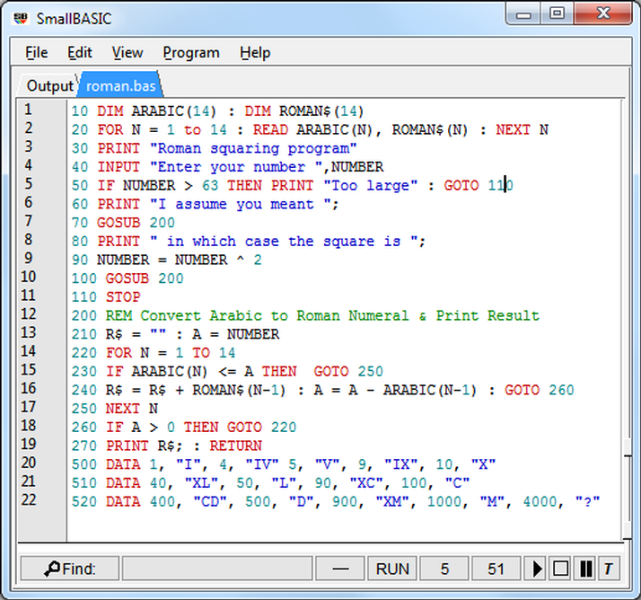
Programming paradigms: imperative
You tell the computer exactly what to do.
Easy to debug.
Easy to implement - it needs the bare minimum of data.
Fast execution (program as good as the programmer).
Hard to adapt to changing goals.
Enter the building, climb to the first floor using the stairs to your left, turn left and go past the hall, enter the second door to your left in the next corridor.

Slide 4
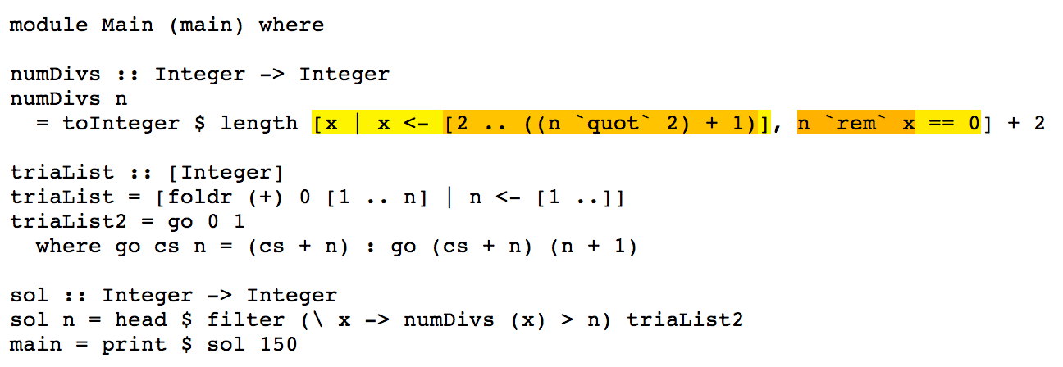
Programming paradigms: declarative
You tell the computer what its goal is.
Hard to debug.
Hard to implement - it needs as much data as possible.
Slow execution (limited control by a good programmer).
It can solve almost anything you can describe.
Go to C309.

Slide 5
Structure of an AI engine
Modeling
Inferring
Learning

Slide 6

Four types of AI: Thinking rationally
Computer manifest logic thought, follows a set of logical rules
Pro: Easy to replicate, easy to prove
Cons: Informal knowledge is not conductive to formal rules, logical solutions are not conductive to informal realities

Slide 7
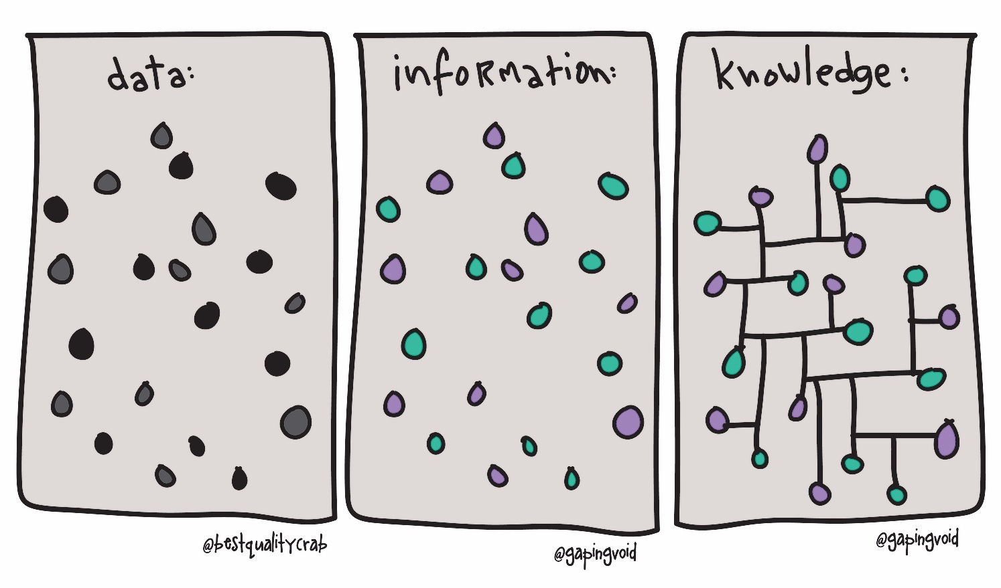
What is knowledge?
Intelligence applied to information produces knowledge.
Knowledge supplements intelligence.
Intelligence is asking the right question, knowledge is having the right answer.

Slide 8
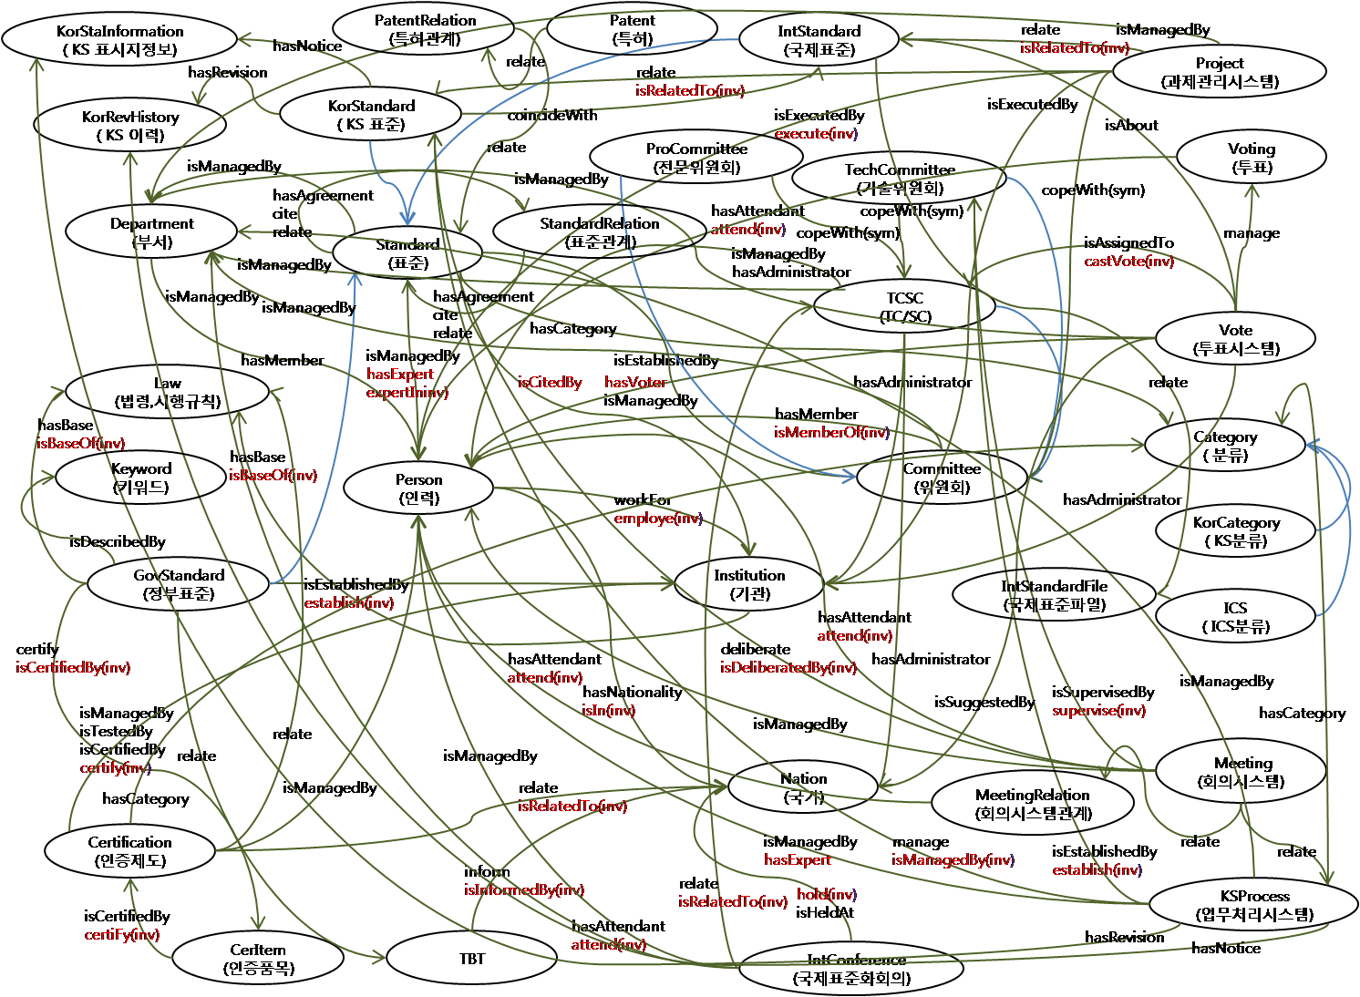
Ontology
Definitions (courtesy of Merriam-Webster):
1: a branch of metaphysics concerned with the nature and relations of being
2: a particular theory about the nature of being or the kinds of things that have existence
Unambiguous representation of knowledge, more expressive than a taxonomy.

Slide 9

Expert systems
Human experts
Expensive
Hard to access
Adaptable
Expert systems
Much cheaper
Very easy access
Little adaptability
Still require human experts in order to be built

Slide 10
Expert knowledge
is next to
A and B are labels (information) used
IF A and B THEN A ‘is next to’ B
IF A ‘is next to’ something THEN something = B
All formal knowledge can be represented like this.
Is an imperative language suitable to implement an expert system?
A
B

Slide 11
Rule Based Programming
Knowledge base: Set of facts known to be true.
Inference rules: Set of IF-THEN rules applied on facts or patterns.
Inference engine: An engine capable of inferring (adding) new facts from the rules and facts available.
Inference Engine
Knowledge Base
Inference Rules

Slide 12

C-Language Integrated Production System
Originally built by NASA from 1985 (original name NASA's AI Language).
Original purpose: diagnosis software for propulsion system.
Since 1996 is an open domain software maintained and developed by volunteers.
Latest version: 6.4.1 (2023).
Official webpage: http://www.clipsrules.net/.
Many libraries available for other languages
accepting CLIPS input: Jess and CLIPSJni(JAVA),
PyCLIPS (Python), CLIPS.NET (.NET)
Online interpreters: https://ideone.com/l/clips
and https://tio.run/#clips

Slide 13
Writing CLIPS code
Everything is a parenthesised prefix (Polish form) notation.
(field1 field2 field3 ….) unlimited number of fields
5 + 2 + 6 * (7 - 2) is written as (+ 5 2 (* 6 (- 7 2)))
Easier to parse: each parenthesis is a call to a function identified by the first field.

Slide 14
CLIPS: Knowledge Base (I)
Contains facts. A fact can be anything (as long as it doesn’t contain & or | or ~ and the first field starts with a char - not a number).
Creating a fact:
(assert (minge))
(assert (lista 1 2 3 4 5))
Creating multiple facts:
(deffacts fapte (minge rosie) (minge mare))

Slide 15
CLIPS: Knowledge Base (II)
Facts are added to the workspace KB. To view current KB:
(facts)
(facts)
f-0 (initial-fact)
f-1 (minge rosie)
f-2 (minge mare)
For a total of 3 facts.
Each fact is assigned (by CLIPS) an unique identifier. All future references to that fact can only be done by referencing that identifier.

Slide 16
CLIPS: Knowledge Base (III)
Deleting a fact:
(retract 1)
(facts)
f-0 (initial-fact)
f-2 (minge mare)
For a total of 2 facts.
Each identifier is unique for the current workspace.

Slide 17
CLIPS: Knowledge Base (IV)
(assert (minge rosie))
(facts)
f-0 (initial-fact)
f-2 (minge mare)
f-3 (minge rosie)
For a total of 3 facts.
For CLIPS, a fact is a pair (id, content). Once retracted, no other fact with the same id can ever exist. This is the first important CLIPS tip. Use it in many situations to control the order of rules, for example by using a fact as a flag/switch.

Slide 18
CLIPS: Inference Rules (I)
(defrule name
(minge rosie)
(minge mare)
=>
(assert (minge frumoasa))
)
Name of the rule. Has to be unique and provided by the user!
}
Left side: conditions (patterns) to be matched on the KB
Right side: actions to be taken affecting the KB

Slide 19
CLIPS: Inference Rules (II)
(rules)
name
For a total of 1 defrule.
(run) - start the inference engine
(facts)
f-0 (initial-fact)
f-1 (minge rosie)
f-2 (minge mare)
f-3 (minge frumoasa)
For a total of 4 facts.

Slide 20
CLIPS: Interacting with the user (I)
(printout t "message" crlf)
t = terminal crlf = carriage return line feed
(defrule read_fact
(minge mare)
=>
(assert (minge (read))
)

Slide 21
CLIPS: Interacting with the user (II)
(read)gets the first field entered at the terminal
(assert (lista (read)))
one two three CR will get (lista one)
To read all fields, use (readline) - will merge all fields before enter into a single field! (lista “one two three”)
To split the input into multiple fields use explode$ :
(assert (lista (explode$ (readline))))
will get (lista one two three)

Slide 22
CLIPS: writing and running code
Step 1: Edit a file with your preferred editor (parenthesis highlight recommended). Save file as name.clp
Step 2: In CLIPS, (clear) the workspace to avoid interference from other facts/rules.
Step 3: (load “name.clp”) , if all is fine T or TRUE will be the last message displayed. This step just checks if CLIPS can understand everything in that file.
Step 4: (reset) CLIPS. This returns the workspace to a state in which all commands from all loaded files are executed.
Step 5: (run) the inference engine.
Highly recommended: keep the facts window opened at all times.

Slide 23
PBR course overview
Course 1,2 and 3: CLIPS, agenda, the RETE algorithm, open and closed worlds, forward and backward chaining
Course 4,5 and 6: PROLOG, logic programming, cuts, recursive procedures
Course 7: Project overview and specifications
Course 8: CLIPS Object Oriented Programming
Course 9: Fuzzy Logic and FUZZYCLIPS

Slide 24
PBR course overview
Course 10: Expert systems: MYCIN, Prospector, Dendral, Mass/Charge, XCON, PXDES, CADET.
Course 11: OPS5 and RC++
Course 12: Constraint Handling Rules
Course 13: DROOLS and EPSILON

